Slide 1
Uncontrolled copy not subject to amendment
Basic Navigation Using Map and Compass

Slide 2
Basic Navigation Using Map and Compass
Learning Outcome 1:
Be able to find a position with an Ordnance Survey map using the physical features of the land

Slide 3
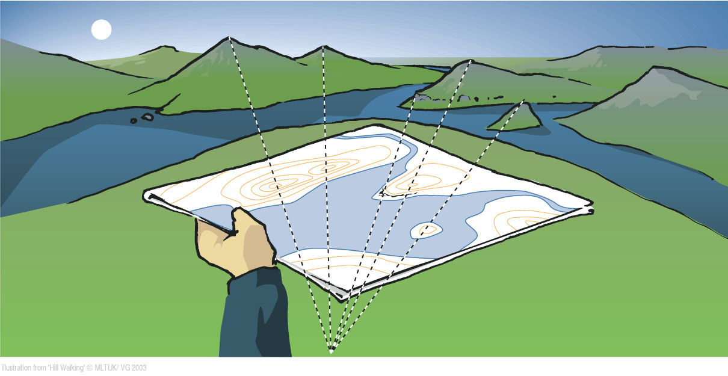
High vantage point
Setting the map to match features on the ground

Slide 4
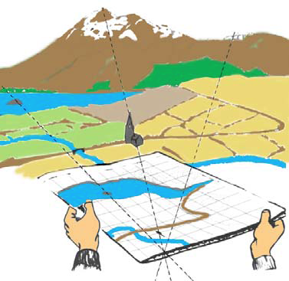
Setting or Orientating the map
Setting the map to match features on the ground
What features can be used in this picture?

Slide 5
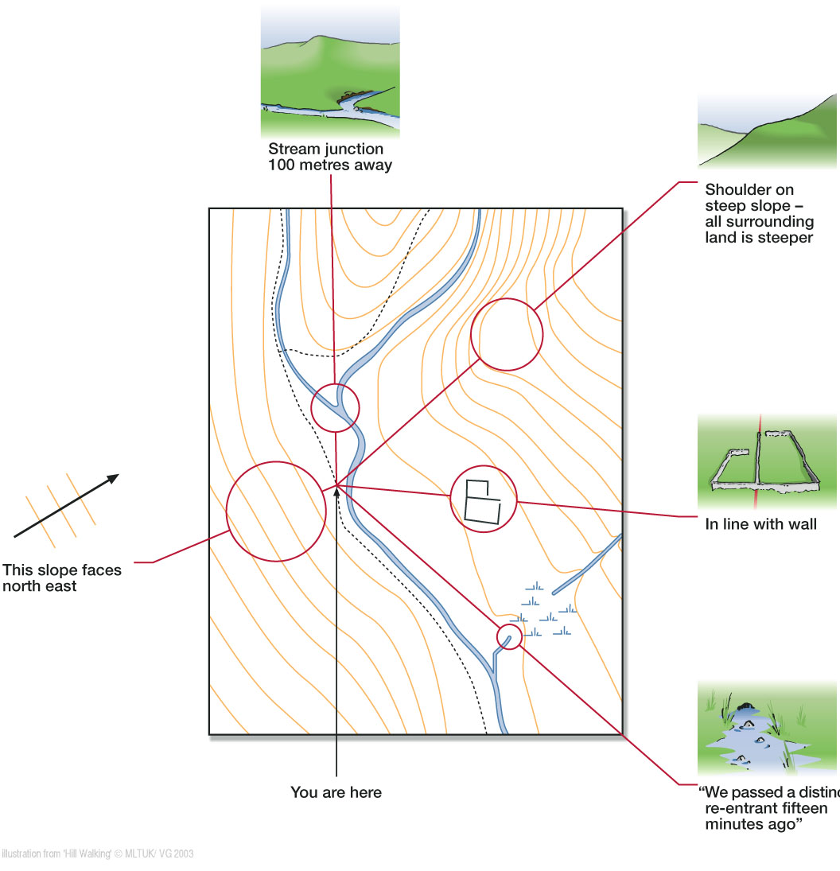
Confirming location

Slide 6
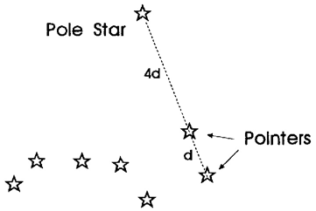
The Pole Star
Finding true north by using the star
constellation of the Plough

Slide 7
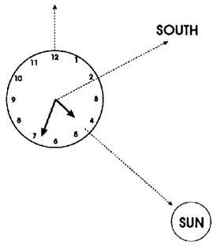
Using a watch
Orienting using a watch

Slide 8
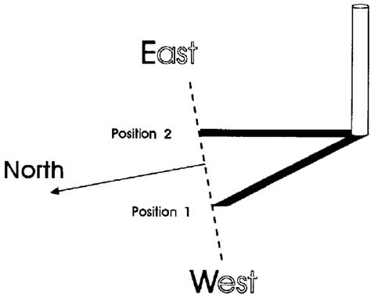
Shadow Method
Using the movement of a shadow to find north

